Slide 1
Open Source for Navigation
Xun(Perry) Liu
4/10/2019

Slide 2


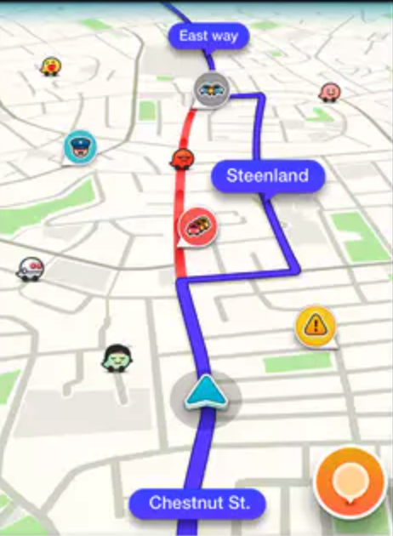
Agenda
How to organize mapdata for map streaming
Calculate route consider dynamic information
Map Matching when the map data is wrong
Notes:
Calculate route consider dynamic information

Slide 3

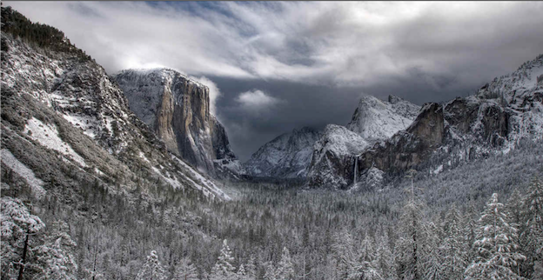
Story #1. How to organize mapdata for map streaming
What is map streaming
Notes:
Off-line navigation
Regional Extracts
Cacheability/Updateability

Slide 4
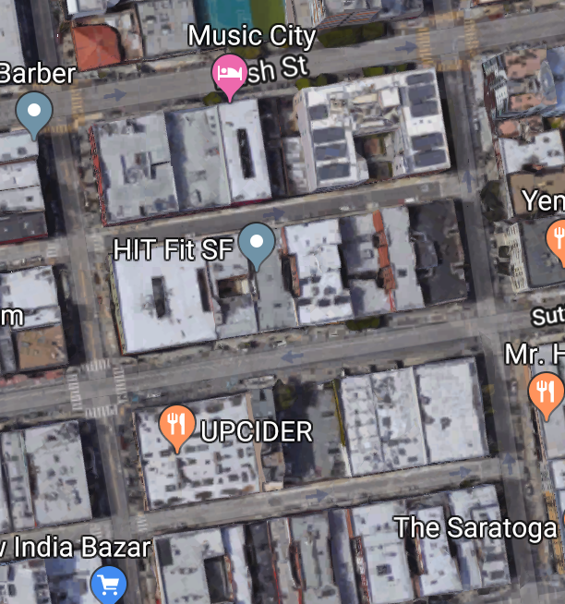
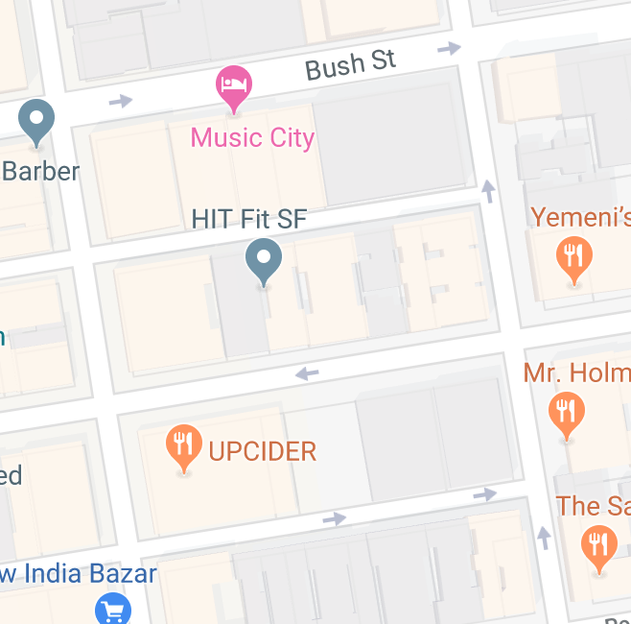
Terminology
Node
Tile1
End
Shortest Path
Tile2
Edge
Start
Graph
Notes:
The original picture tells the feature of destination adjustment from Lyft

Slide 5
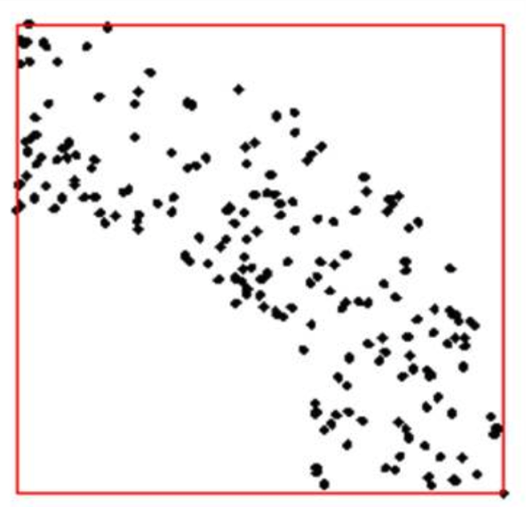
How to store data
How UBER find nearest rider for you?
Group data based on geometry
Elements near to each other record together
Balanced group
Notes:
Add current data statistics

Slide 6
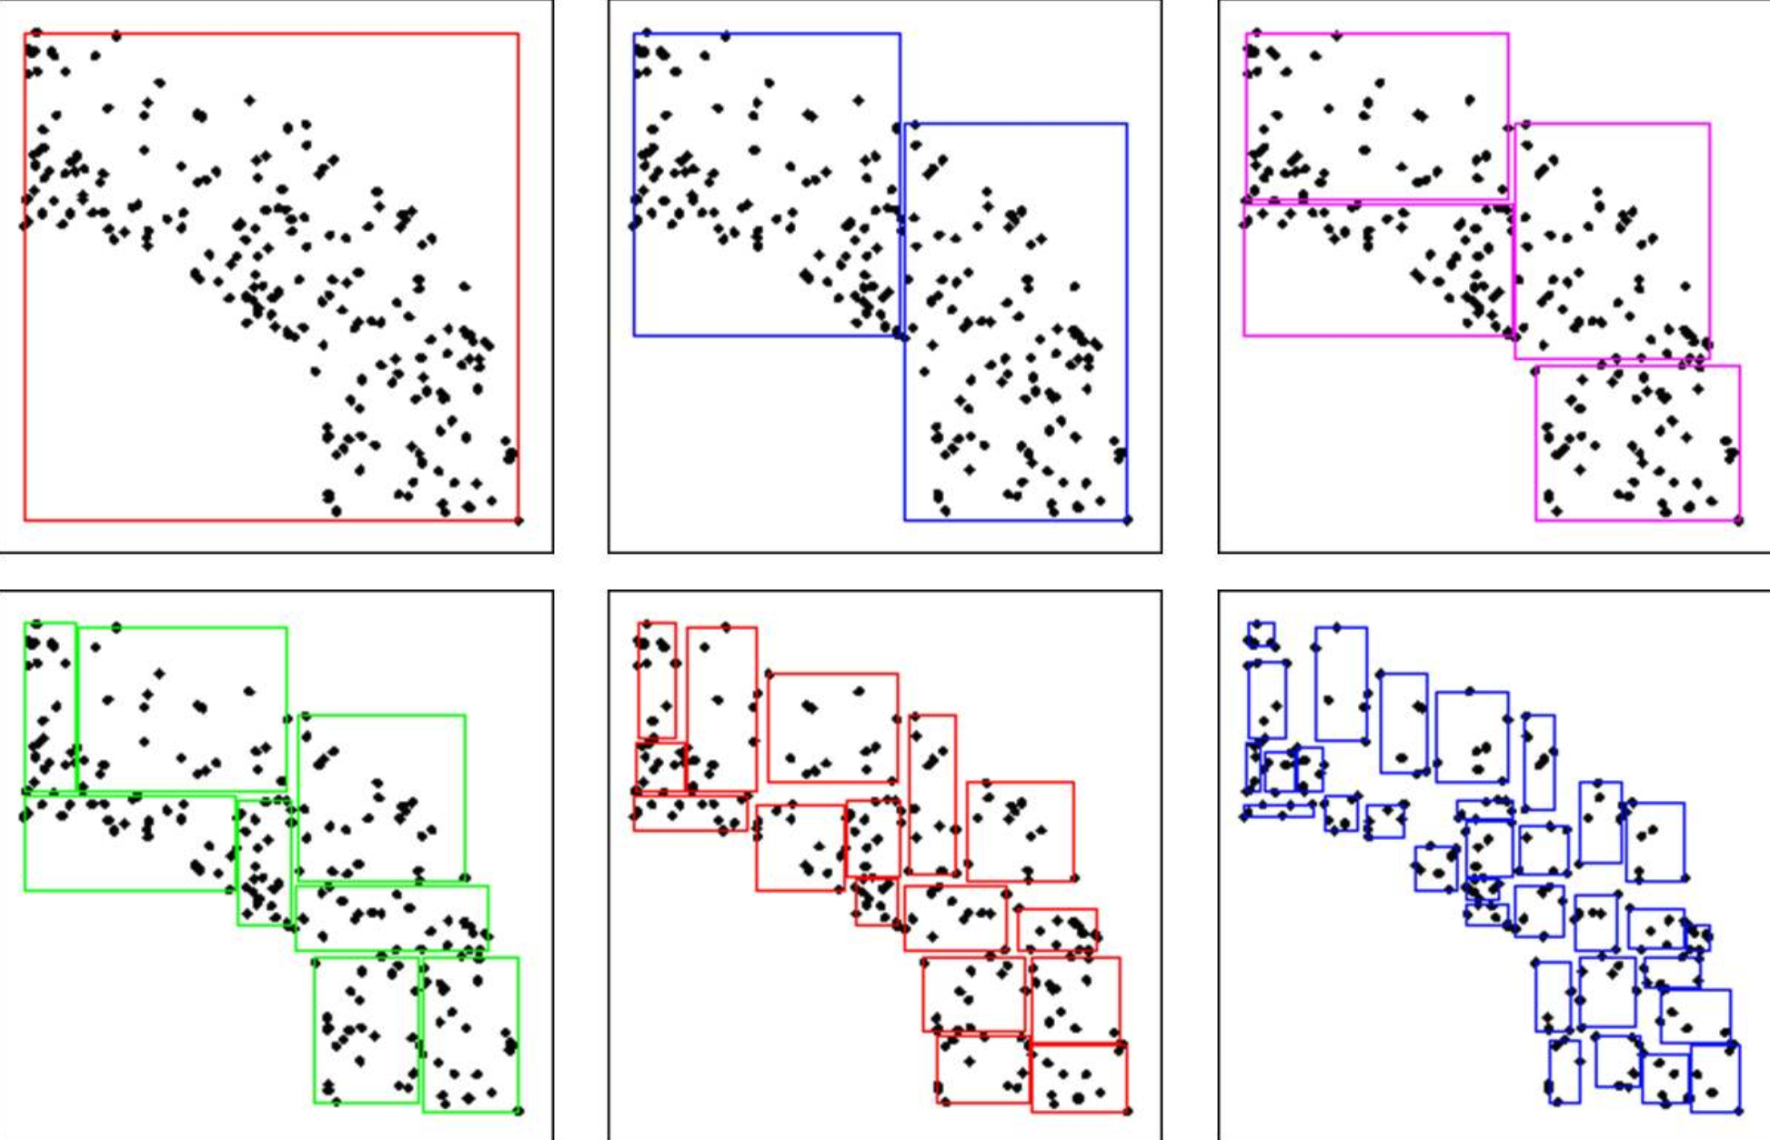
KD split
Average count is 2000~3000
Average file size is 700KB
Easy to implement
Element might move to different tile during data update
Need additional meta data
Notes:
Add current data statistics

Slide 7
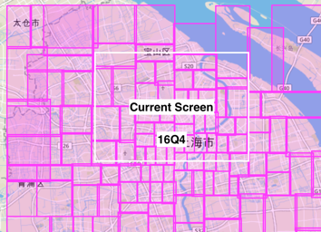
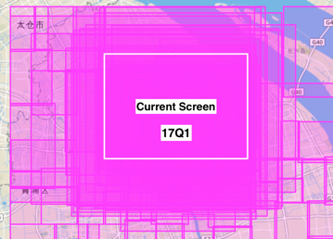
Issue
16Q4
17Q1
Notes:
Add current data statistics

Slide 8
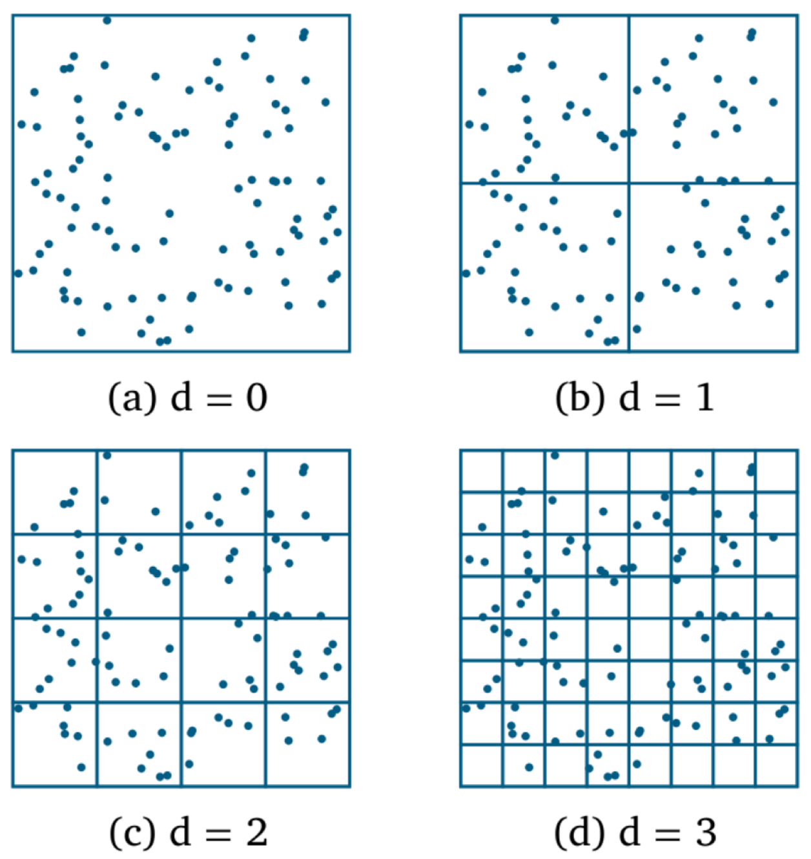
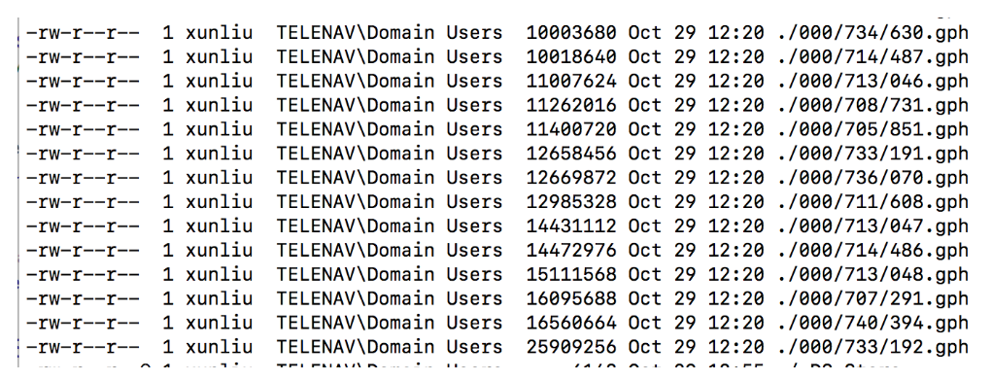
Keep data element stable/Get tileid by latlon
Fixed boundary split
Element will stay in fixed grid as long as no change for geometry
Grid id could be calculated by lat/lon
Cacheability/Updateability
File size depend on data density
25MB

Slide 9
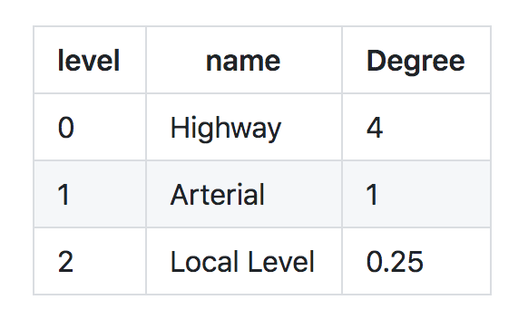
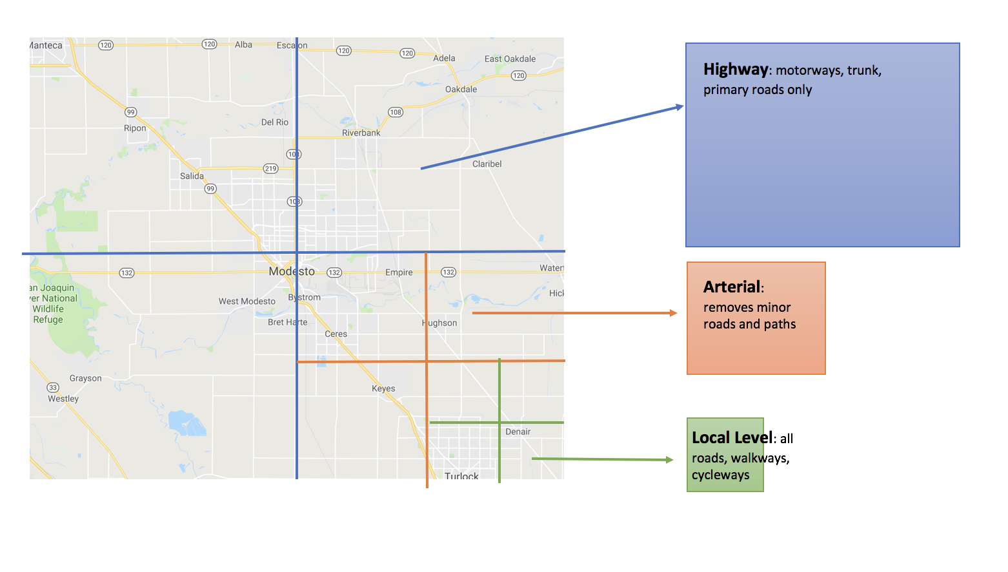
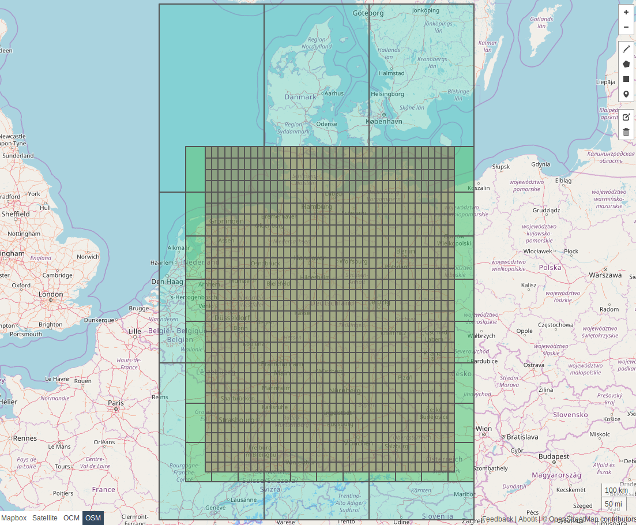
Valhalla Tiles
Fixed boundary tile

Slide 10
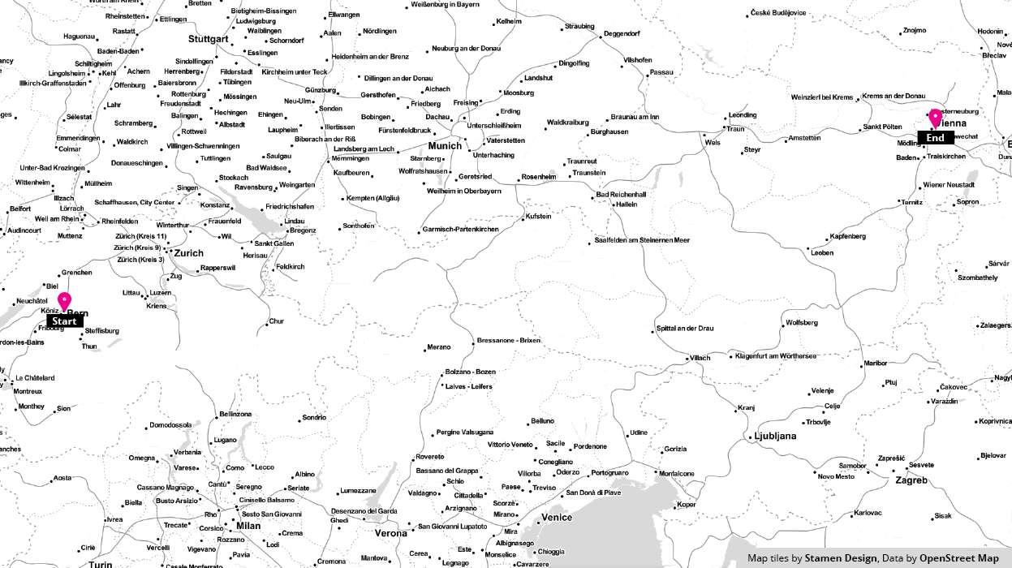
Valhalla Route calculation

Slide 11

Lesson learned
Low level data organization affects feature tradeoff
Improvement on Current product
Fix boundary at space level, then try at tile level
Re-build boundary’s connectivity based on geometry and road names/type etc

Slide 12

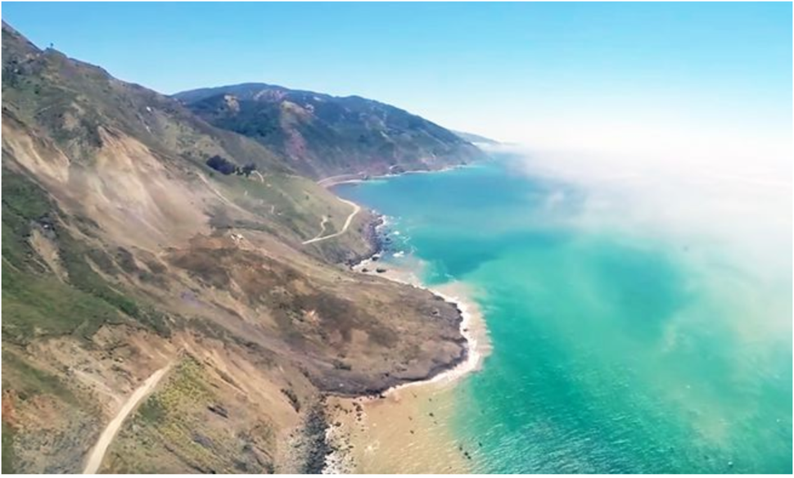
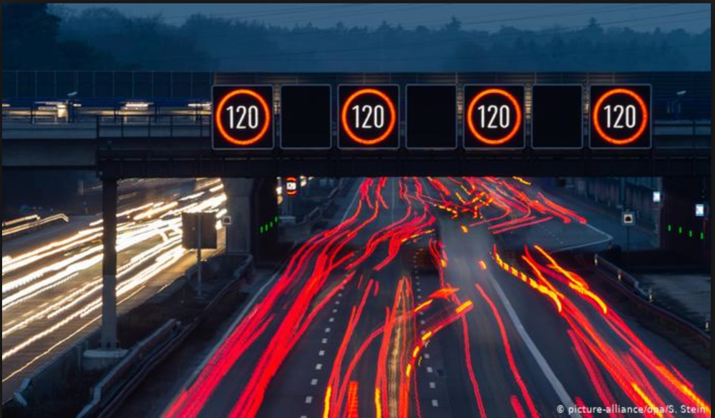
Story #2 Calculate route consider dynamic information

Slide 13
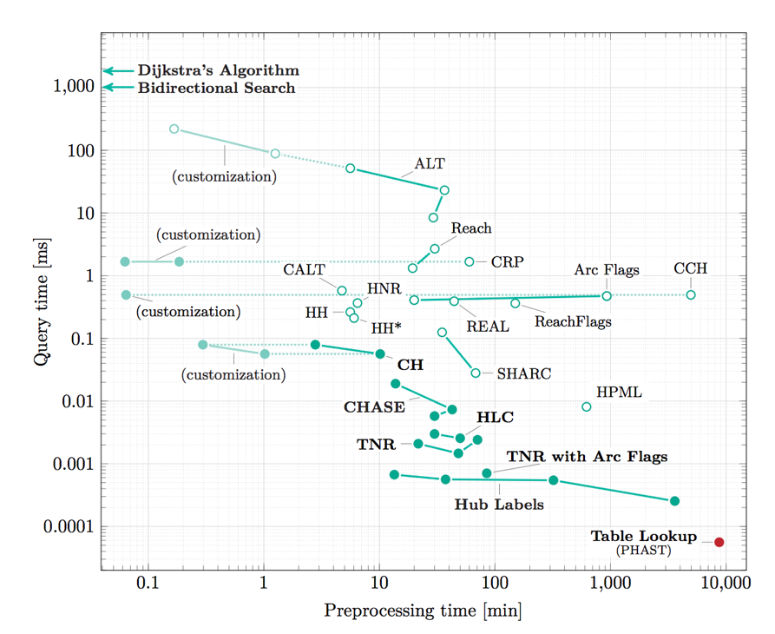
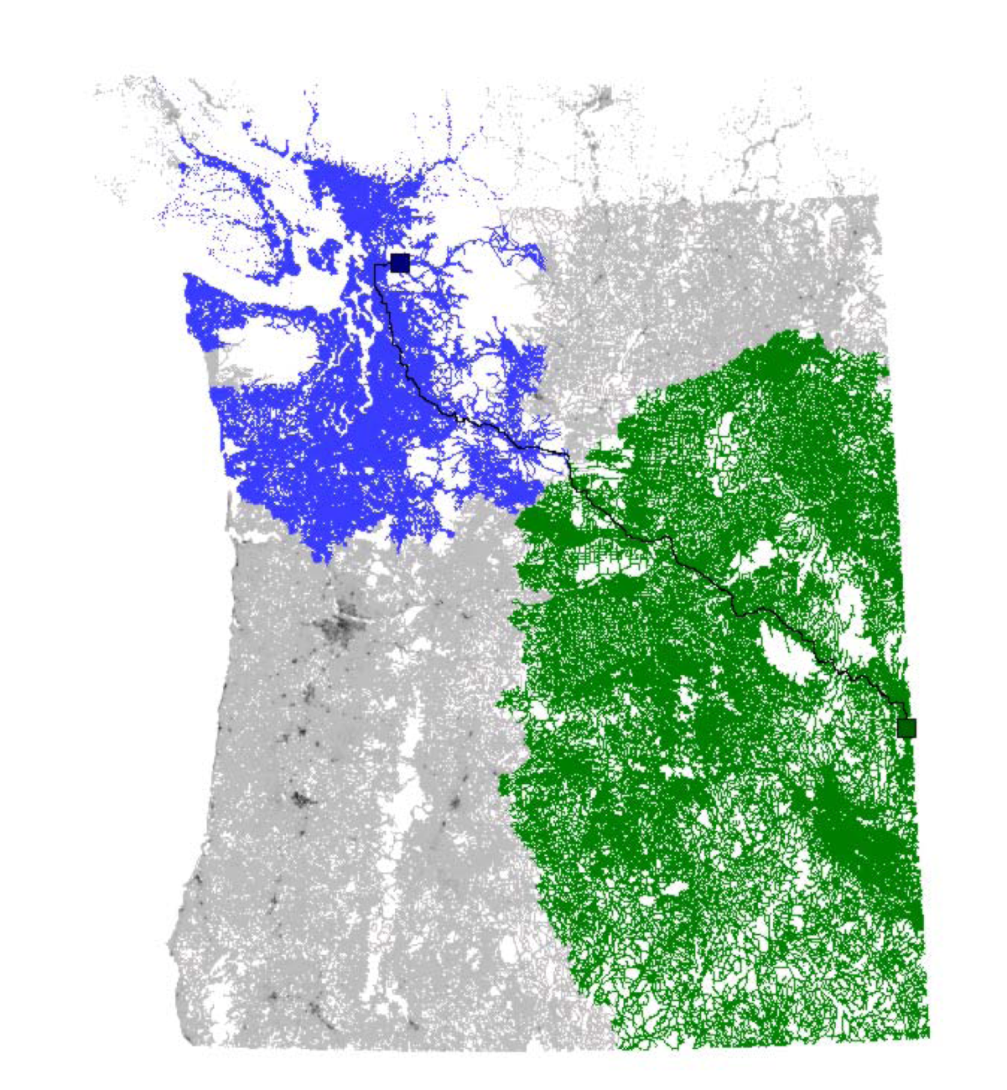
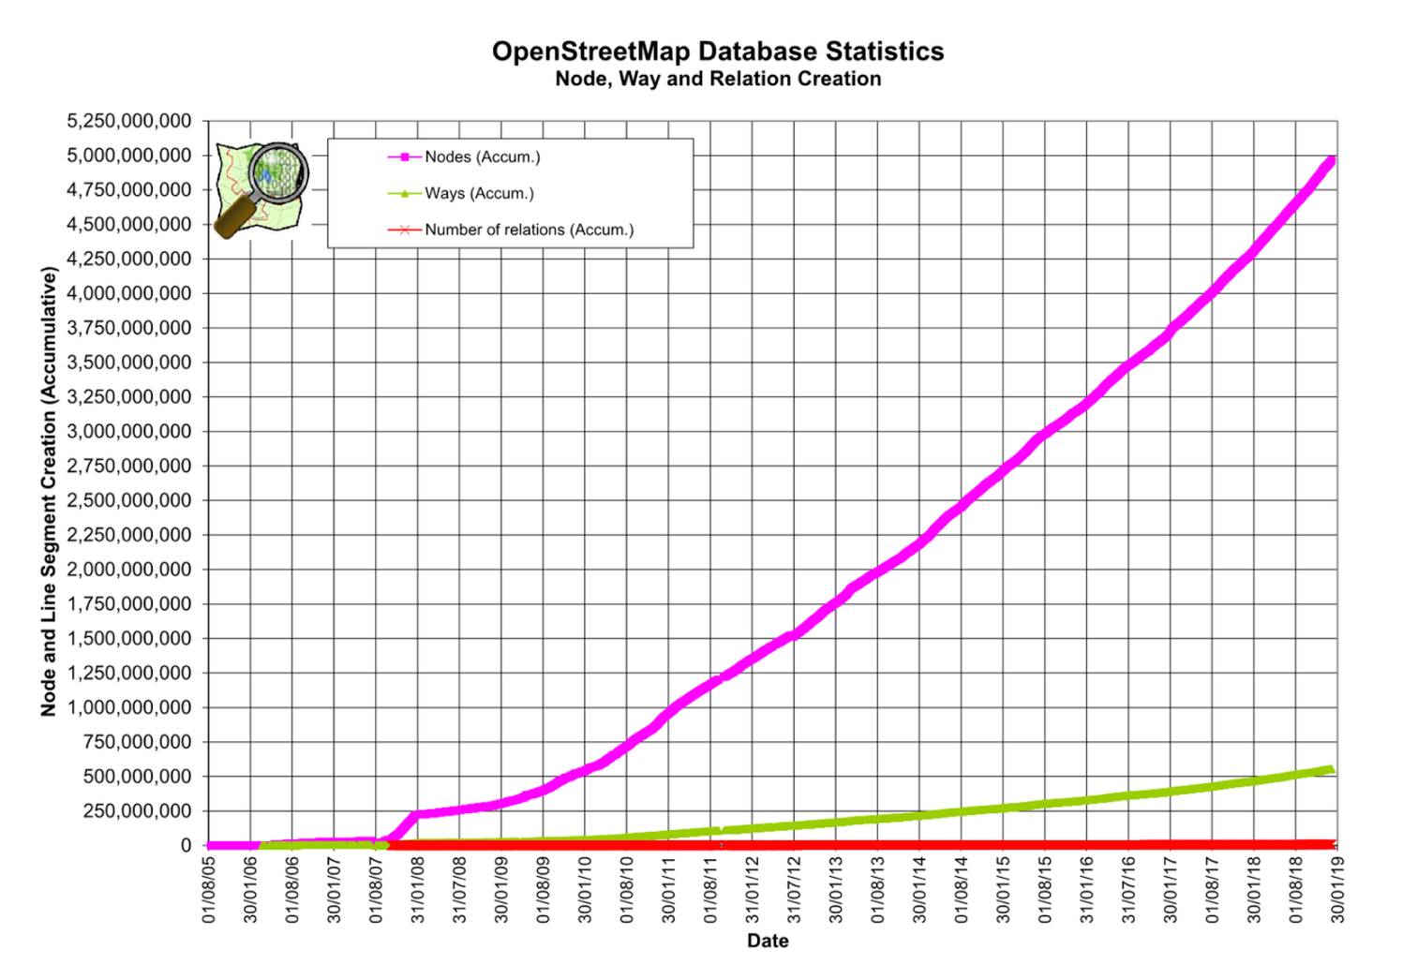
Story #2 Calculate route consider dynamic information
Chanllege of routing + dynamic information
400M edges for HERE NA
800M edges for HERE EU

Slide 14
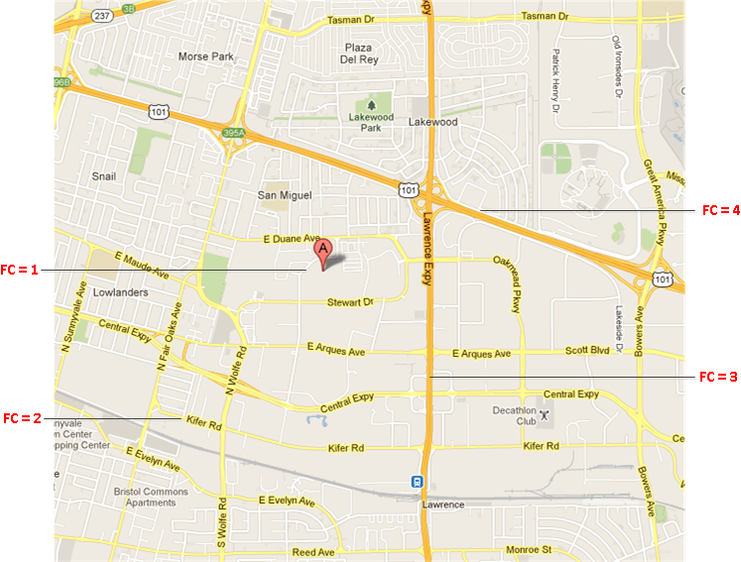
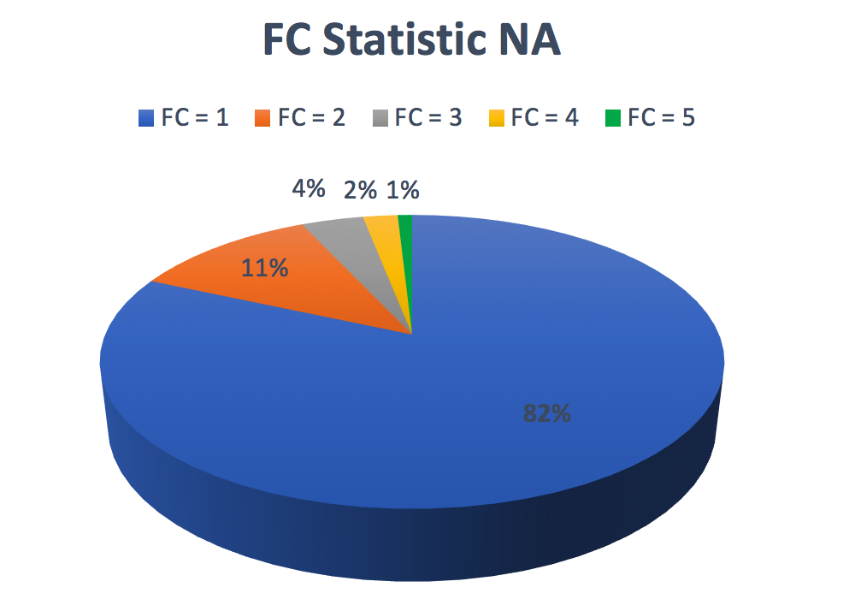
Function class Level promotion
Notes:
The original picture tells the feature of destination adjustment from Lyft

Slide 15
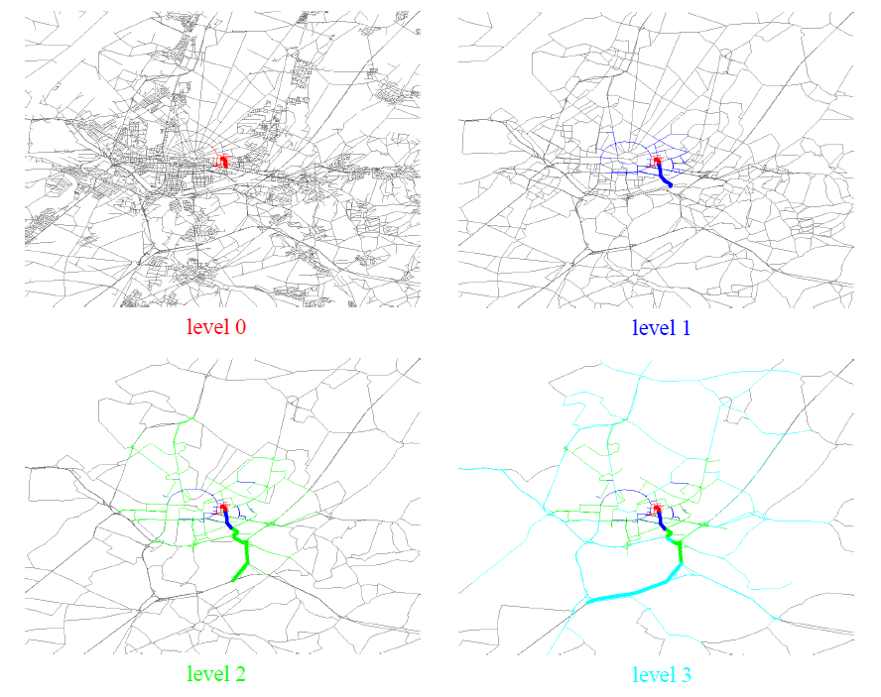
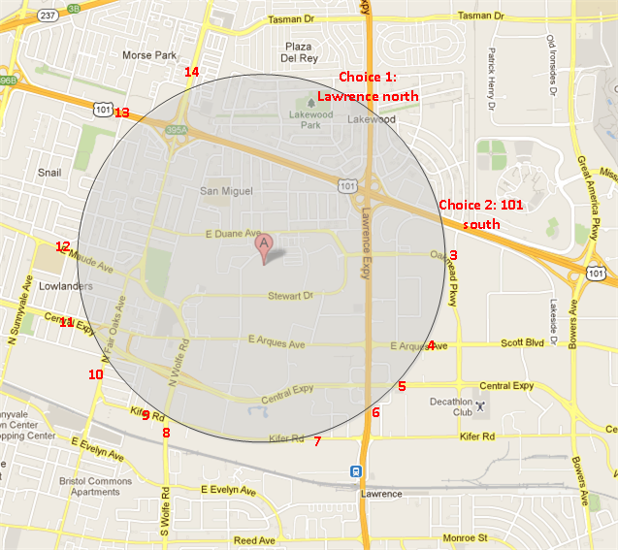
Function class Level promotion
Prune and Shrink
When to promote

Slide 16
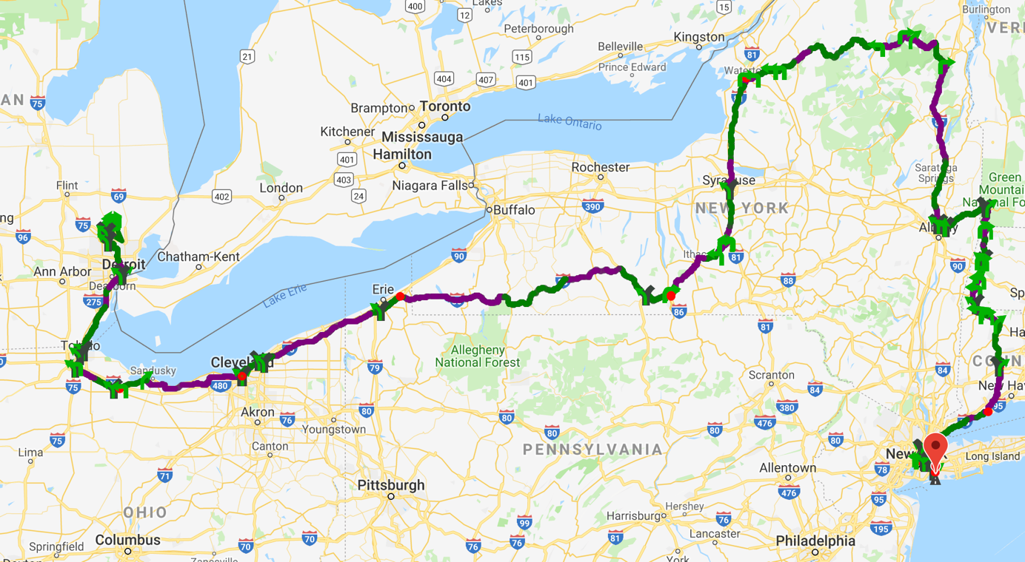
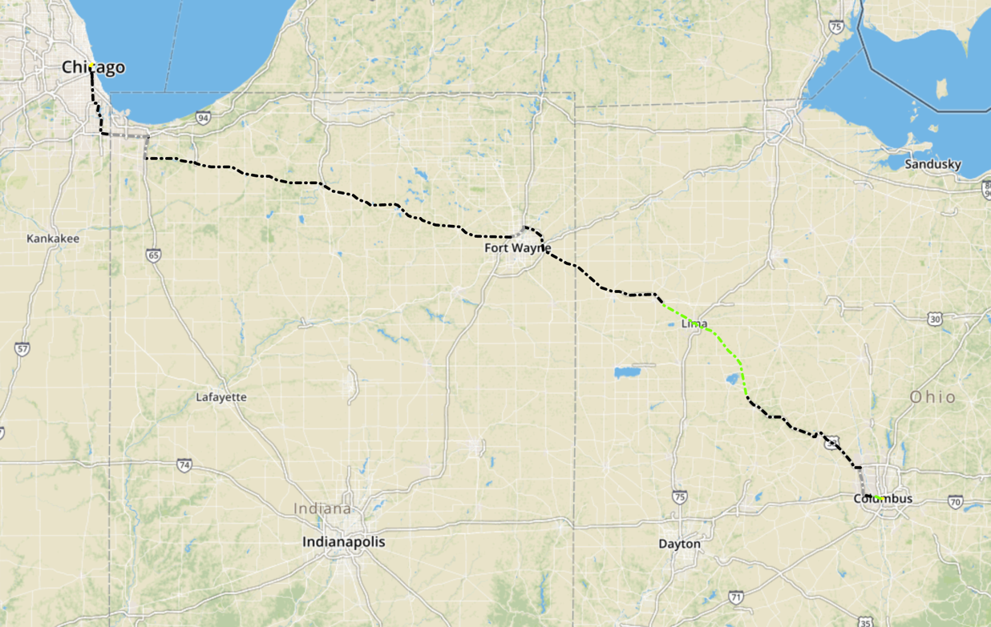
Function class Level promotion
Miss best candidate
Notes:
The original picture tells the feature of destination adjustment from Lyft

Slide 17
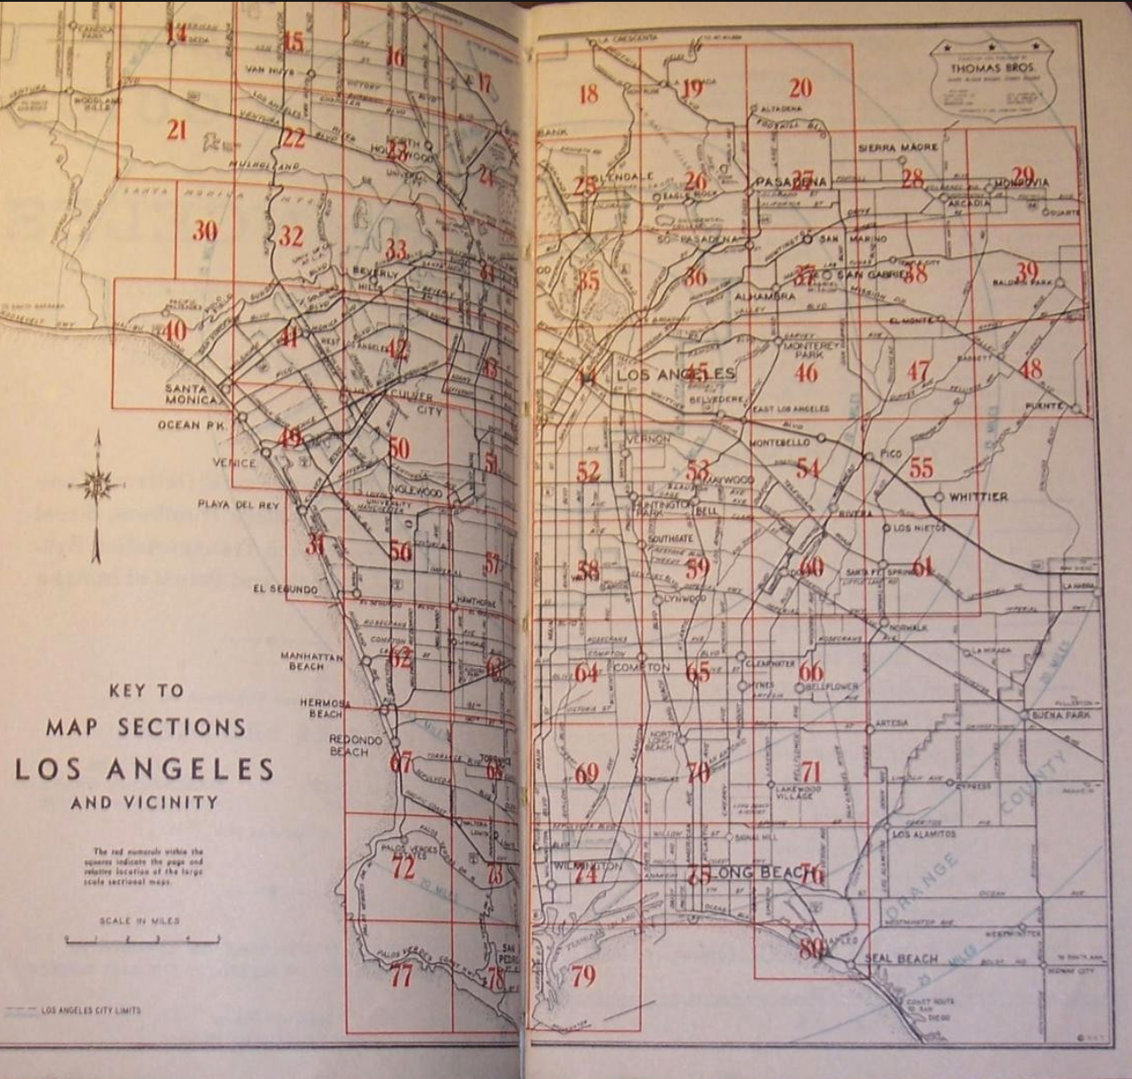
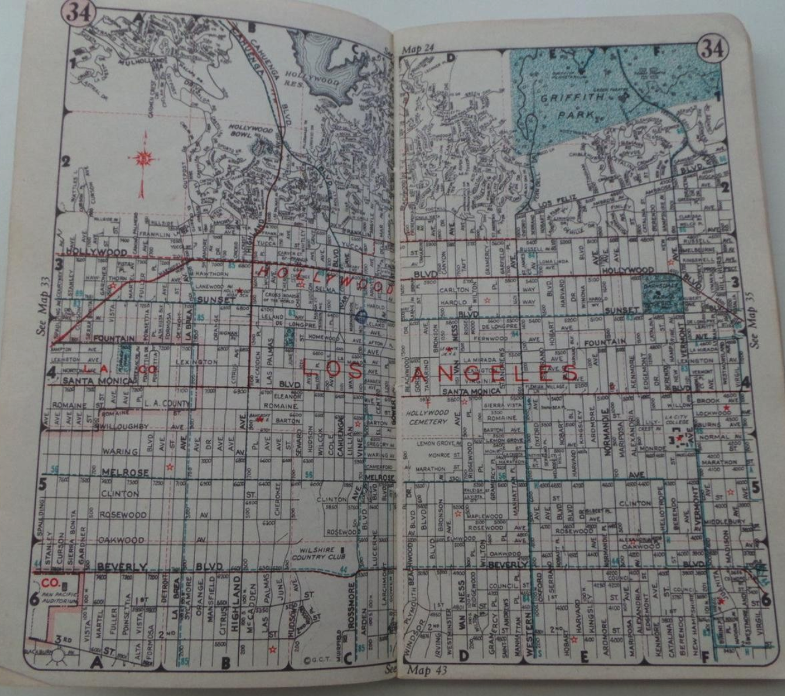
Thomas Guide
Notes:
The original picture tells the feature of destination adjustment from Lyft

Slide 18
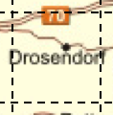
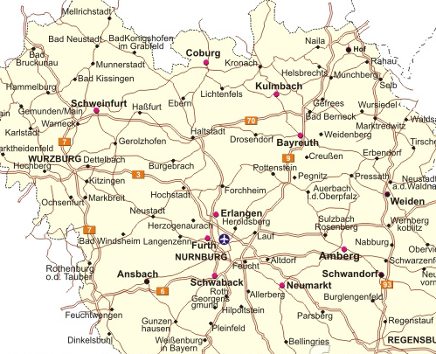
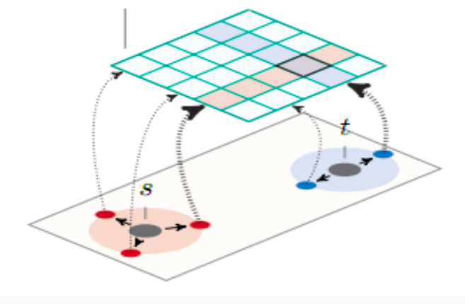
Partition the graph
Boundary edges
Boundary edges
By fixed size grid
Boundary edges
Notes:
The original picture tells the feature of destination adjustment from Lyft

Slide 19
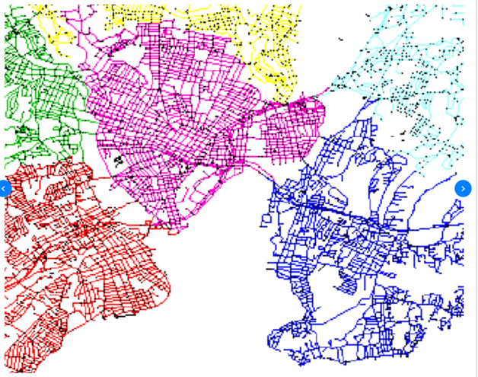
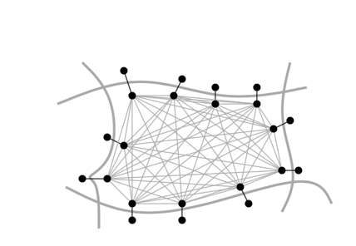
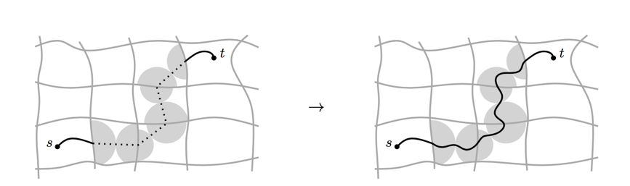
Customizable Route planning
Step 1: Metric independent preprocessing
Graph partition, preprocessing, hours
Step 2: Customization
Apply dynamic information with cost model
Each round of traffic update, seconds
Step 3: Query
Real time, per request, mili-seconds
Notes:
The original picture tells the feature of destination adjustment from Lyft

Slide 20
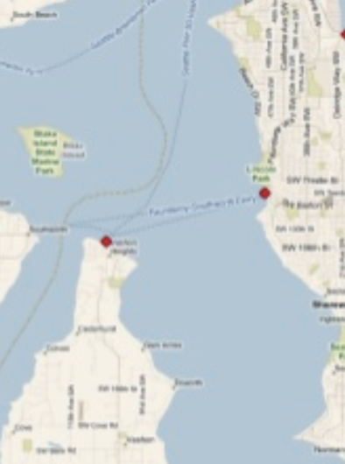
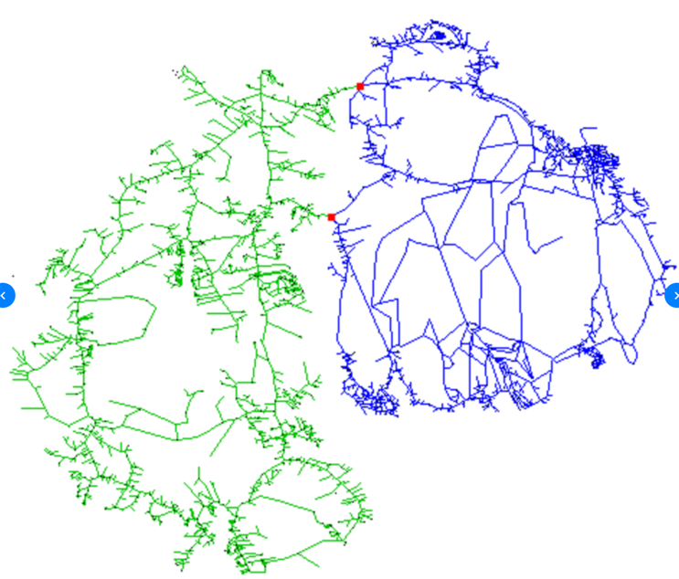
How to find min-cut
Notes:
The original picture tells the feature of destination adjustment from Lyft

Slide 21
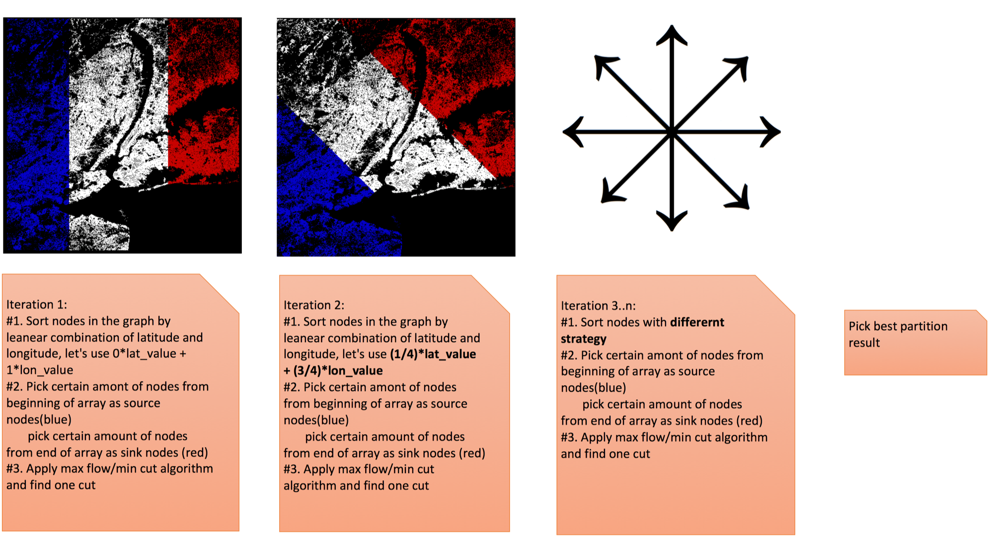
How to find min-cut

Slide 22
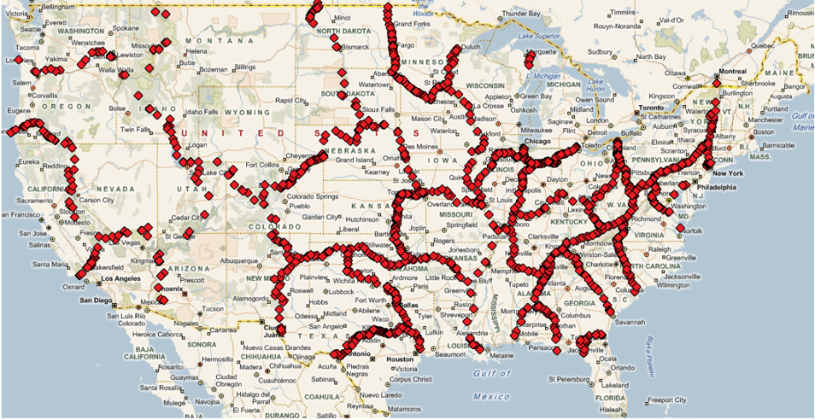
Cut result of US
Notes:
Picture come from the paper of PUNCH

Slide 23
Max Flow Min Cut

Slide 24

Lesson learned
Cloud side could use different strategy compare with embedded side
Accurate algorithm matters especially for ML
Improvement on Current product
Divide and conquer
Everything hide behind API
Docker/Lua/Cucumber

Slide 25
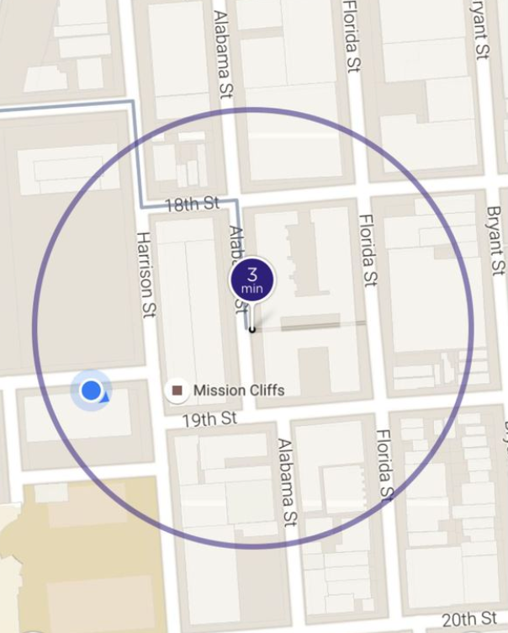
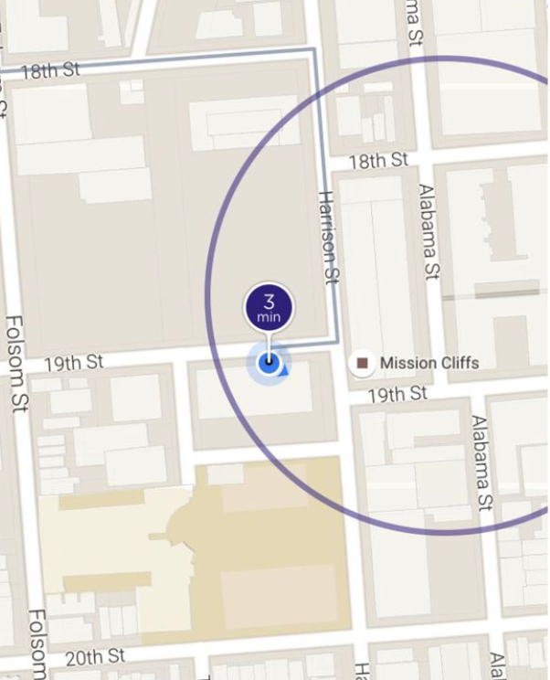
Story #3 Map Matching when the map data is wrong
A story about Lyft pick up
When Map data exists
No Map data
Notes:
The original picture tells the feature of destination adjustment from Lyft

Slide 26
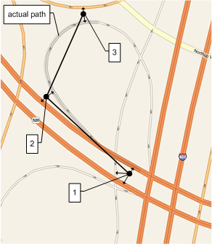
Offline Map Matching
What/How/Why
Give a sequence of GPS signals, find the most probable sequence of road segments

Slide 27
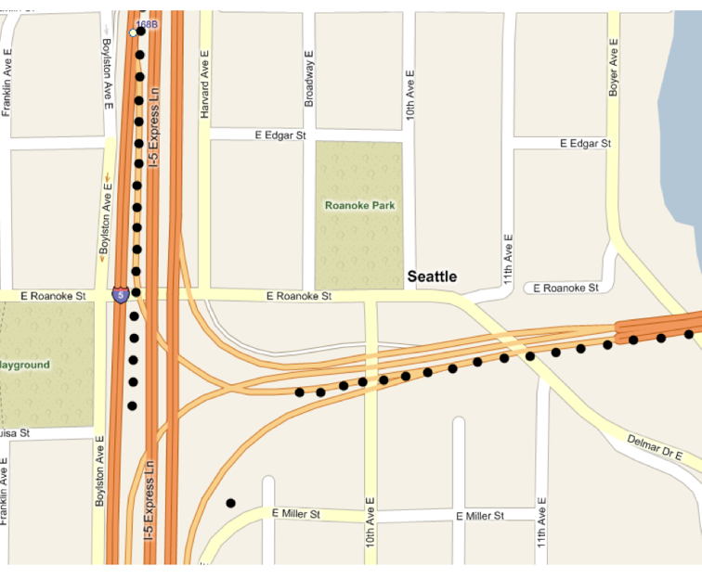
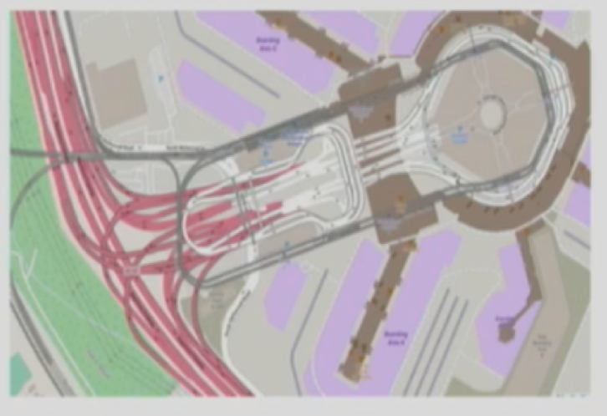
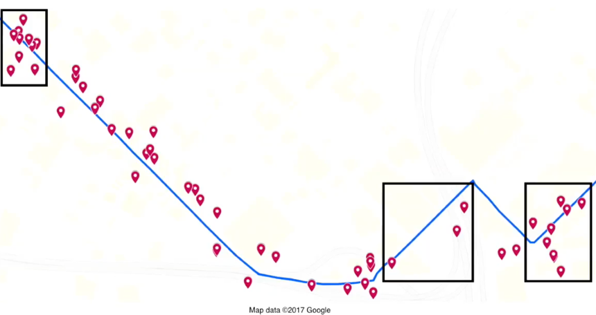
Offline Map Matching
What/How/Why/
Noise & Sparseness
Missing GPS
Wrong/Complex Map Data

Slide 28

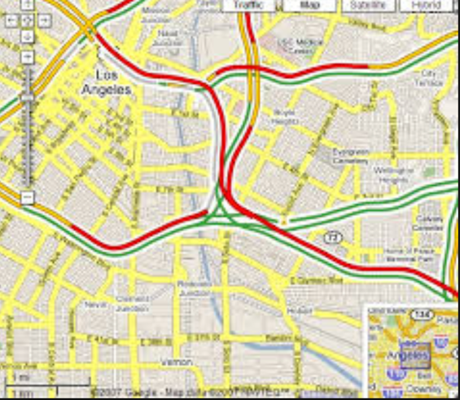
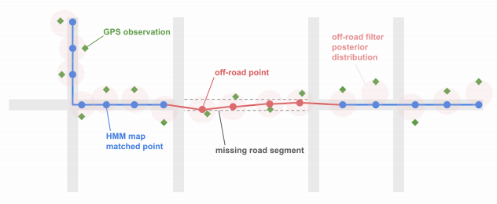
Offline Map Matching
What/How/Why
Historic/Live traffic/ETA
Enhance map data
User pattern
Notes:
Live traffic
Enhance map data
Analysis user pattern

Slide 29

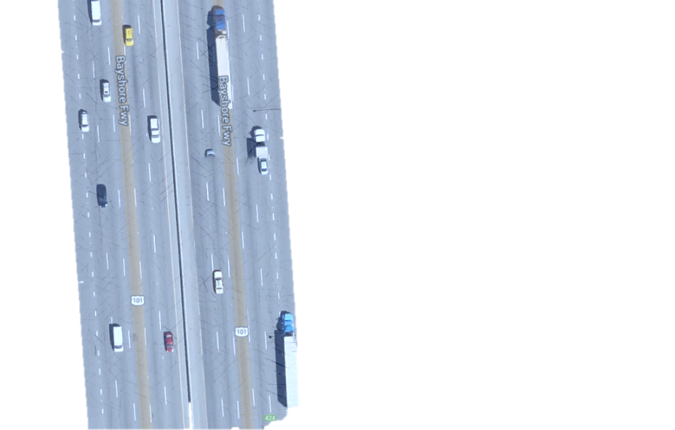
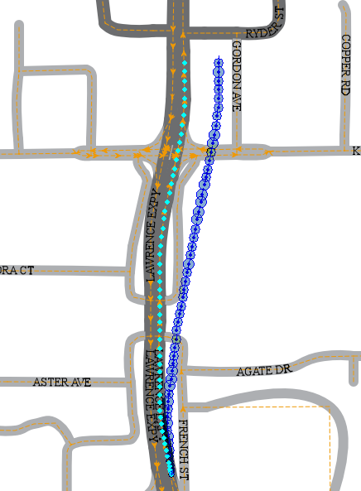
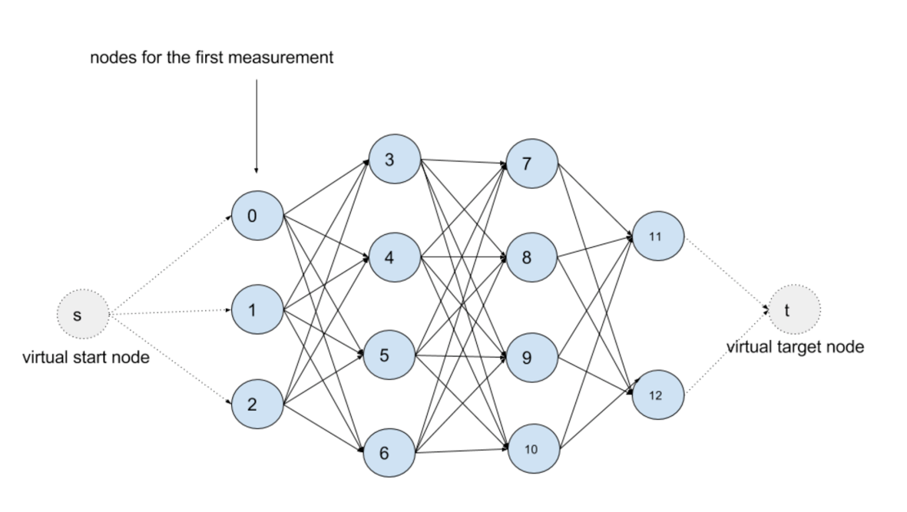
Map Matching logic
Lifecyle
Filter noise points
Find Nearest edges as Candidate
Consider Connectivity
Optimal path
99% (2.05*errsize)
Kalman Filter
95% (1.65*errsize)
67% (1.00*errsize)
Emission Probability
MM Fix
DR Fix
Road Width
dmin
Transition Probability
Viterbi Algorithm
Hidden Markov Map Matching

Slide 30
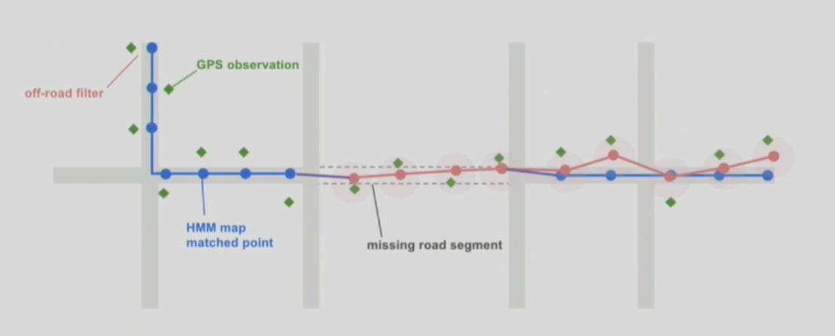

When map is wrong (LYFT’s way)

Slide 31


Lesson learned
Build infrastructure stack based on open source with active community
The unique and valuable data is the core of your business

Slide 32
When map is wrong (LYFT’s way)

